Slide 1
HR ANALYTICS data analysis project
P- 214 | Group 4 | Mentor:

Slide 2
great vision without great people is irrelevant.
-Jim Collins

Slide 3
CONTENTS
Introduction
Meet the team
KPI-1 : Average Attrition rate for all Departments
KPI-2 : Average Hourly rate of Male Research Scientist
KPI-3 : Attrition rate Vs Monthly income stats
KPI-4 : Average working years for each Department
KPI-5 : Job Role Vs Work life balance
KPI-5 : Attrition rate Vs Year since last promotion relation
Dashboards & Queries : Excel, SQL, Power BI & Tableau

Slide 4
INTRODUCTION
The project aim to analyze the HR dataset of Attrition Rate of Employees, through a report to get insights from it by using different software tools such as Excel, MySQL, Tableau and Power Bi.
We used for analyzing, cleaning and removing duplicates from datasets and prepared dashboards and insights accurate business decisions are made.

Slide 5
Data set
Data Set | HR_1 | HR_2
No. of Rows | 50k | 50k
No. of Columns | 18 | 18
File Format | .xlsx | .xlsx
Dataset type | Excel Data | Excel Data

Slide 6
Tools used in the project
Excel
MySQL
Tableau
Power-BI
Data Exploration
Data Cleaning
Visualization
Data Exploration
Retrieving Relevant Data according to KPIs
Joining multiple Files
Visualization
Joining multiple Files
Data Exploration
Data Cleaning in Power Query
Visualization

Slide 7





Data analysis process
Step 1
Step 2
Step 3
Step 4
Step 5
Define the Question
Collect the data
Clean the data
Analyze the data
Visualize and Share the Insights

Slide 8





MEET OUR TEAM
Mr. Abhishek RT
Mr. Naveen M C
Mr. Sabarish K P
Mr. Kanchu Sai Charan
Miss Sarita Aghadate
Kadire Akhila
Mrs. Venkata Lakshmi Anusha Macherla

Slide 9
KPI-1 : Average Attrition rate for all Departments
This KPI is to find out the relationship between each department and its attrition rate, and here attrition rate is highest for Research & Development Department whereas lowest is for Hardware Department.
We can clearly say that the attrition rate of employees for every department is almost 50%, which indicates that the attrition rate of employees does not depend on the department.
So, irrespective of the department, almost 50% of employees are leaving the company.
From this calculation and visualization, we concluded that we must make strong strategies to minimize attrition rate and improve our company’s employee retention so that we can balance the company’s growth and right talent.

Slide 10
KPI-2 : Average Hourly rate of Male Research Scientist
The average hourly rate of Male Research scientist is 115.16
Whereas the average hourly rate of Female Research scientist is 115.93
The average hourly rate of Human resources, Laboratory technician, Manufacturing Scientist and Research Scientist are almost same i.e., 115.

Slide 11
KPI-3 : Attrition rate Vs Monthly income stats
An terms of attrition rates and monthly income statistics, the Hardware Department stands out with a notably lower attrition rate of 49.22% in comparison to the other departments. Contrastingly, the Research and Development team experiences a comparatively higher attrition rate of 51.42%.
Despite this, the team boasts an impressive average monthly income of $26,257, which ranks among the highest across all departments – notably surpassing the average monthly income within the Hardware Department. In summary, with the exception of the Hardware Department, all other departments exhibit attrition rates exceeding 50%, yet they tend to enjoy more favorable average monthly incomes.

Slide 12
KPI - 4 : Average working years for each Department
Average working years for - Sales Department is 17.01% which is highest number of years people worked and most satisfied employees in sales department.
The list average working years for hardware with 16.32% and Human resource , software will comes with group off higher avg working years, Research and development and support will have least avg working years.

Slide 13
KPI-5 :
Job Role Vs Work life balance
Balancing your job role with work life balance is a continuous effort to ensure that your professional responsibilities and personal well being are both adequately addressed.
Let's break down the relationship between your job role and work life balance. Job role : your job role refers to the specific responsibilities, tasks and duties you have within your organization or profession.
your job role might involve specific skills expertise and contributions that you bring to your workplace. Work life balance:
work life balance refers to the equilibrium between your work related commitments and responsibilities and your personal life including family, hobbies, health and leisure activities.
Achieving work life balance promotes well being, reduce stress, burnout and negative impacts on personal relationships.

Slide 14
KPI-6 :
Attrition rate Vs Year since last promotion relation
The relationship between attrition rate and the number of years since the last promotion can vary based on the specific context and organization. However, in many cases, there could be a potential relationship between these two factors.
Here are a few possible scenarios: Inverse Relationship Company Culture and Management Practices Industry and Job Roles.
To understand the specific relationship between attrition rate and years since the last promotion in a given organization, it's important to analyze relevant data, conduct employee surveys, and consider other factors that might contribute to attrition.
Keep in mind that correlation does not imply causation, and multiple factors can influence attrition rates in complex ways.

Slide 15
Dashboard & Queries
Excel, Tableau, Power-BI & SQL

Slide 16
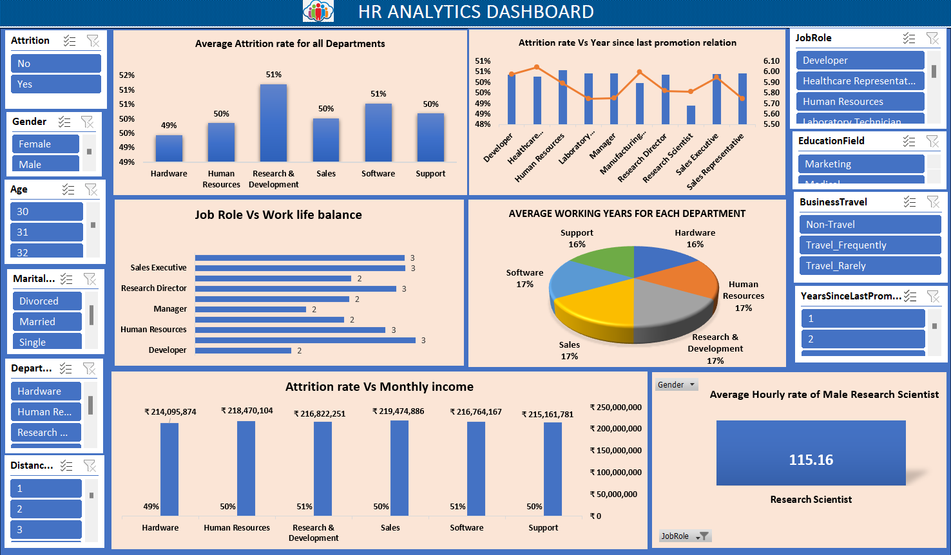
Excel Dashboard

Slide 17
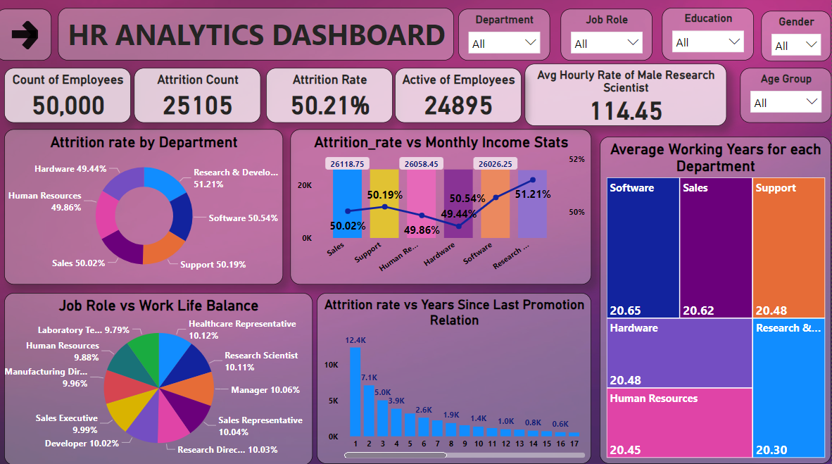
POWERBI Dashboard

Slide 18
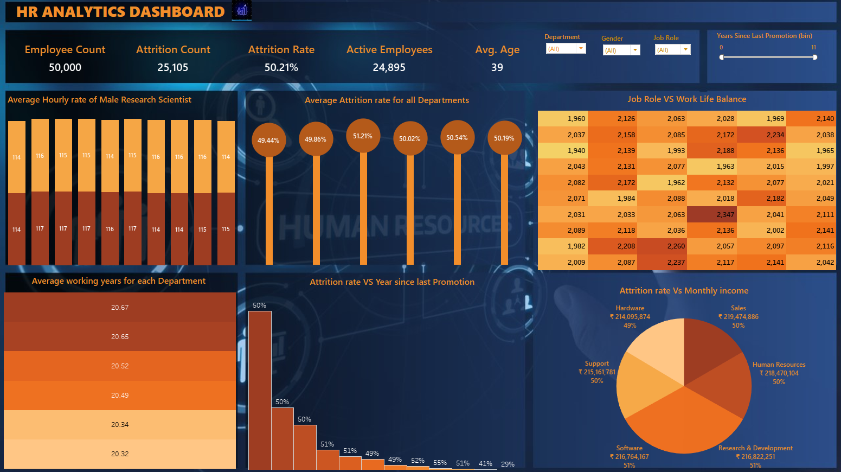
TABLEAU Dashboard

Slide 19
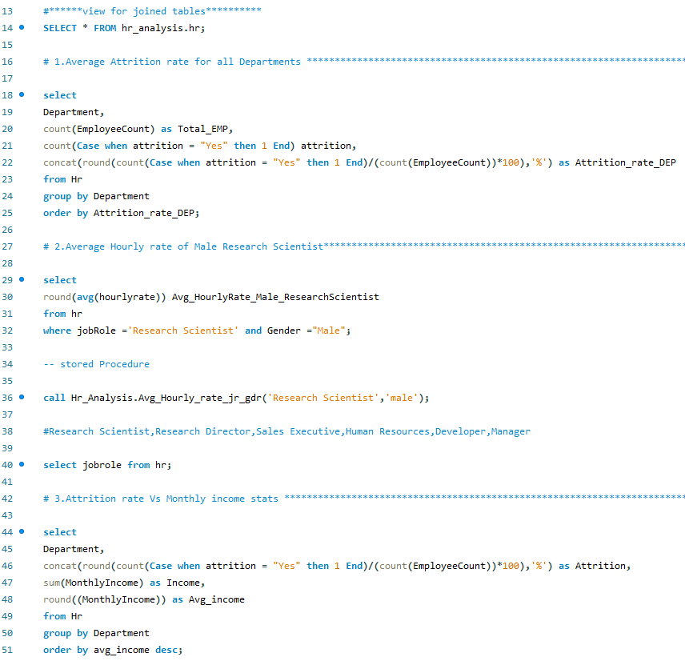
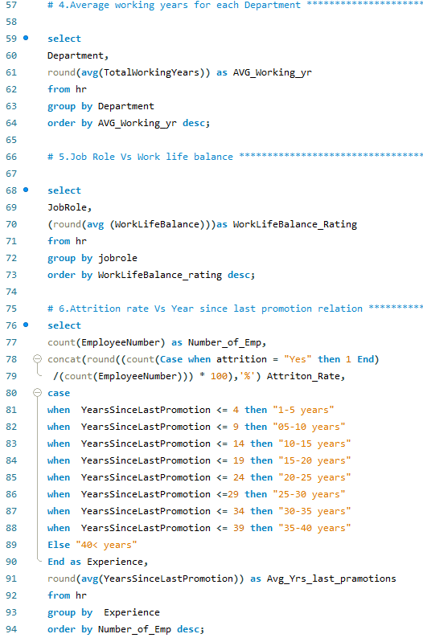
SQL Queries and results

Slide 20
cONclusiON
From the analysis of above dashboards and reports we can draw hidden insights. With the use of gained insights from the HR datasets and KPI’S. Accurate Business decisions are made and can track the business state.

Slide 21
THANK YOU

